Slide 1
AFRICA
Quality Management

Slide 2
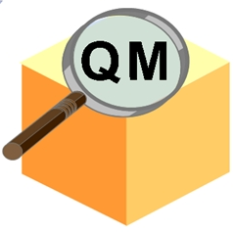
QM Master Data
1. Material Master Data (QM View)
2. Catalogue
Selected Set
7. Certificate Profile
MASTER
DATA
3. Inspection
Method
6. Quality Info Record
(Q-Info Record)
4. Master Inspection
Characteristics (MIC)
5. Inspection Plan

